Slide 1

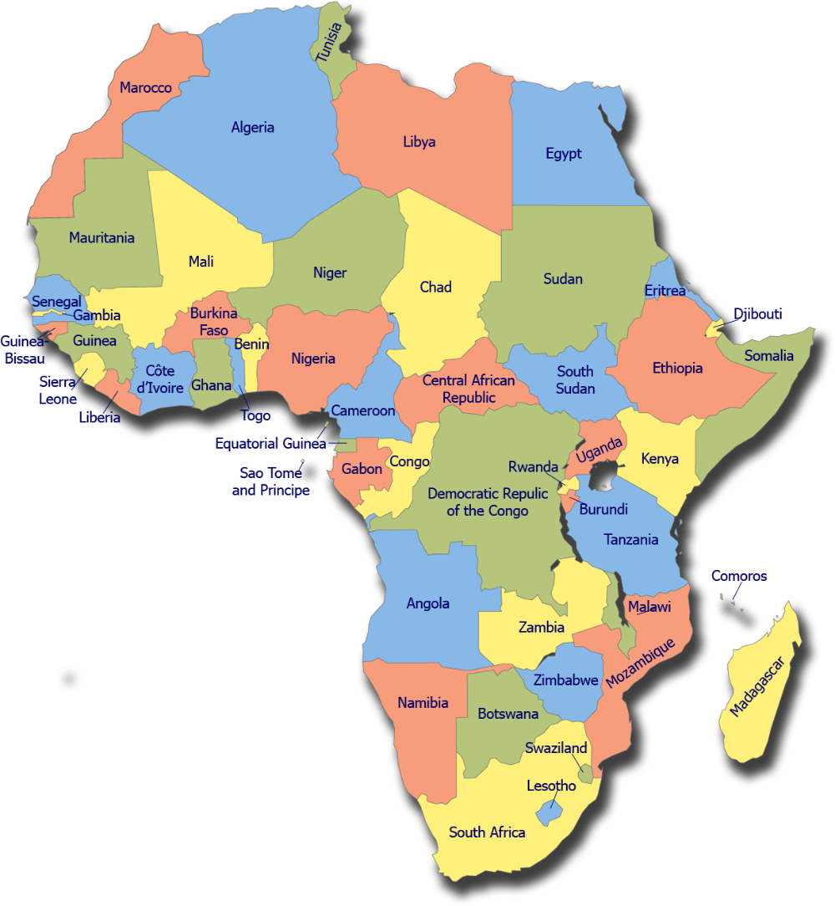
Forecasting the Probability of a Conflict Arising in an African Nation
TEAM THEANO CAPSTONE PROJECT
May 6, 2023

Slide 2
Our Team
Other Active Members
Project Lead
Name: Bamgbola Samuel Aduragbemi
Assistant Project Lead
Name: Tanya Shekhawat
Query Analyst
Name: Peace Onyekachi
Chrispine Tot
Monicah Omondi
Omojasola Juwon Ezekiel
Kafayat Ibrahim
Lateefah Ajadi

Slide 3
Presentation Outline
Introduction
Problem Statement
Process Flow
Exploratory Data Analysis
Feature selection and engineering
Model Training and Evaluation
Summary of Solution
Conclusion

Slide 4
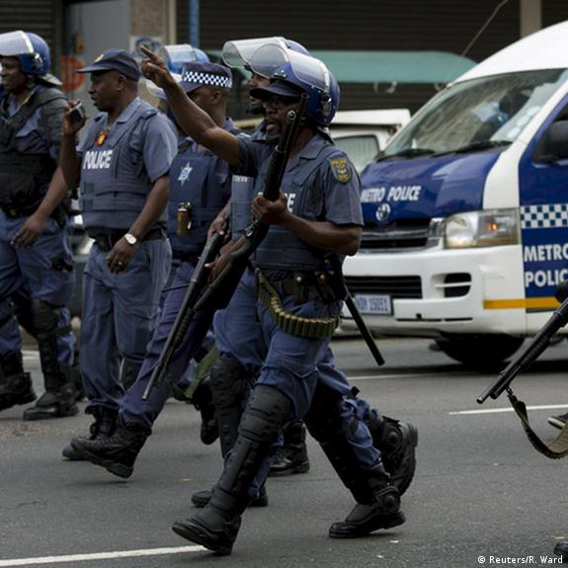
INTRODUCTION
A crime is a form of violence or illegal act performed by perpetrator(s) against another in order to cause harm to person or property which is punishable by the authority. Directly or indirectly, crime affects people's lives. It is a major variable that affects the development of a country.
Crimes in African nations keep rising which span from a range of violent and non-violent actions by political agents, including governments, rebels, militias, identity groups, political parties, external actors, rioters, protesters and civilians.

Slide 5

Problem Statement
To analyze crime rates and fatalities in various African countries, as well as the variations among different actors and actor groups and their contributions to total crimes and fatalities recorded.
To observe patterns in the trend in crime rate over the years from 1997 to 2023 (March 31st), and the factors that are most dominant or differ the most in the top 3 and bottom 3 countries in terms of crime rate.
Build a crime analytics and forecasting tool that assesses fatalities threat level based on disorder type, actor, and possible crime events, leveraging insights from historical data to inform pre-emptive policy decisions.

Slide 6
Process Flow

Slide 7

About the Data
The Armed Conflict Location and Event Data Project is designed for disaggregated conflict analysis and crisis mapping. This dataset codes the dates and locations of all reported political violence and protest events in dozens of developing countries in Africa.
The project covers all African countries from 1997 to March 31st, 2023.
These data contain information on: - Dates and locations of conflict events - Specific types of events including battles, civilian killings, riots, protests and recruitment activities - Events by a range of actors, including rebels, governments, militias, armed groups, protesters and civilians - Changes in territorial control and - Reported fatalities

Slide 8
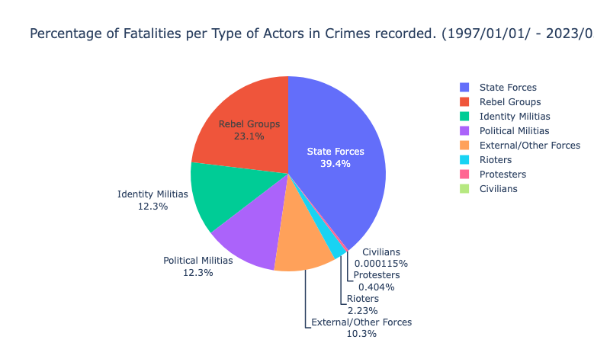
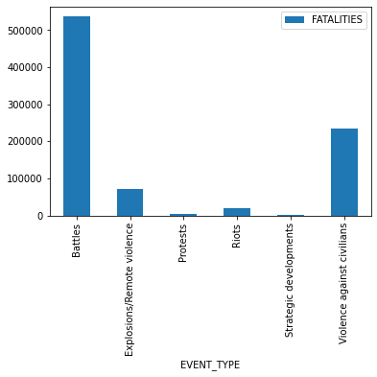
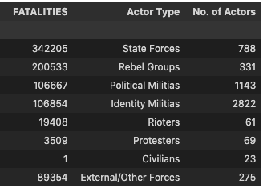
Exploratory Data Analysis
These visuals show how fatalities of crimes in africa vary in event types and the actor types involved in the crimes.

Slide 9
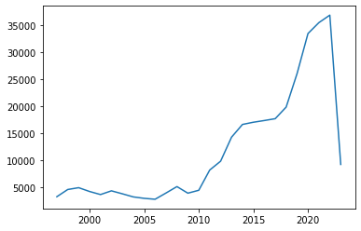
We can see the trend of number of crimes committed per year begin to increase steadily from 2009.
There is a steep drop in total record of crimes in 2023 because the records stop at March 31st.
To add a bit of context, we can see that the total number of crimes recorded so far in 2023 exceeds the total recorded in 2011. This just means that the rate of crime has increased very largely over the years.

Slide 10
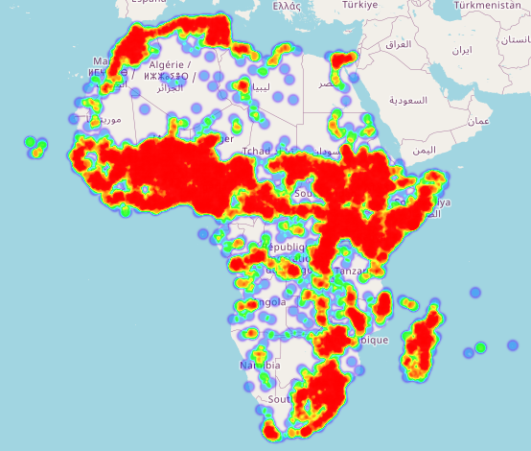
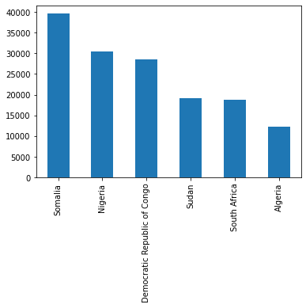
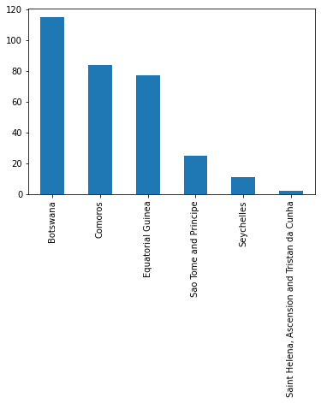
Heatmap representing Hotspots of Crime in 2022
Top Countries in crime rate
Bottom Countries in crime rate

Slide 11
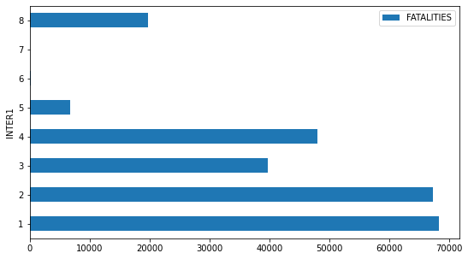
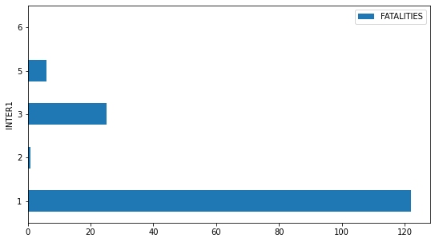
Analysis of Top 3 and Bottom Countries 3 in Crime rate
Influence of Actor groups on Fatalities in Top Countries in Crime rate
Influence of Actor groups on Fatalities in Bottom Countries in Crime rate
Actor type 1 which represents State Forces, has the most contribution to number of fatalities in both cases.
Actor types 2, 3 and 4 which are rare in the countries with least number of fatalities recorded are common in the high fatality countries.
We can then assume that State Forces, Rebel Groups, Political Militias and Identity Militias are responsible for crimes incurring high number of fatalities.

Slide 12

Feature selection and engineering
For feature selection, columns with no missing data were chosen except for ADMIN1 which was manually filled after searching for the right value based on other columns. Selected features included event date, event type, sub event type, and actor1.
One hot encoding was performed on categorical features with fewer number of categories while label encoding was used for columns with a large number of categorical variables. Target variable (Fatalities) was binned into seven categories/levels. The training set was then scaled using standard scaler and dimensionality was reduced to 98 components from 121 using Principal Component Analysis.

Slide 13

Model Training and Evaluation
The XGBClassifier algorithm from xgboost was used to train the model on the pre-processed dataset. The target variable chosen was Fatalities, which was binned into seven categories/levels.
To address the class imbalance in the target variable, we used the ‘class_weight’ parameter from the ‘utils’ module in the Scikit-learn library to compute sample weights based on the target variable's distribution. The generated sample weights were then passed into the xgboost model during fitting to improve the model's ability to handle the imbalance. This resulted in a trained model that can effectively predict the target variable with high accuracy.

Slide 14
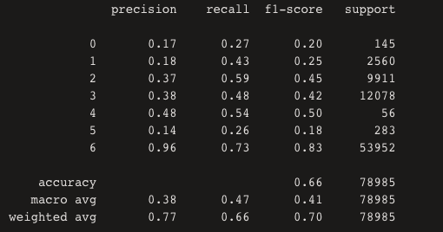
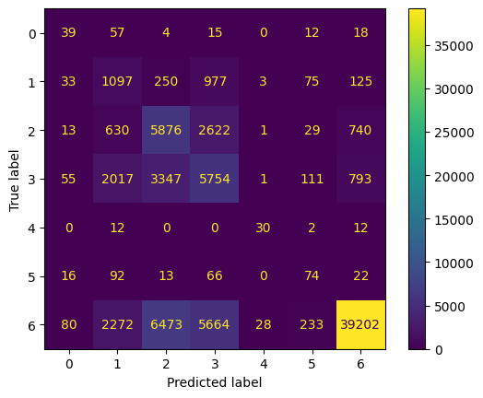
Fatalities label encoding
{'NO_FATALITY': 6,
'1_FATALITY': 2,
'2_TO_10': 3,
'11_TO_50': 1,
'51_TO_100': 5,
'101_TO_500': 0,
'501_TO_1350’: 4}
Evaluating the model, we got an f1-score of 0.70 and a precision of 0.77 which are very good for the size of the dataset. The model can further be improved in the future leveraging deep learning algorithms.
And for the predictions that were wrong, majority fell to the next level in the range of fatalities, which means our model generalised well on the dataset.

Slide 15

Summary of Solution
We successfully provided a solution to our defined problem statement.
A pre-processed dataset was used to train an xgboost model that effectively predicted the target variable (fatalities).
A crime analytics and forecasting tool was built to assess the threat level of fatalities based on disorder types, actors, and possible crime events. The tool leverages insights from historical data to inform pre-emptive policy decisions.
Link to Web App - https://bit.ly/africa-crime-forecasting-tool
Link to GitHub repo - Team-Theano-Capstone-Project

Slide 16
Conclusion
Our solution provided a comprehensive analysis of crime rates and fatalities in various African countries, with insights into the contributions of different actors and actor groups. Our analysis also highlighted the patterns in the trend of crime rate over the years, and the factors that are most dominant in the top and bottom countries in terms of crime rate.
Our findings underscored the importance of considering location, time, and actors when analysing crime to make informed policy decisions.

Slide 17
THANK YOU

